Slide 1
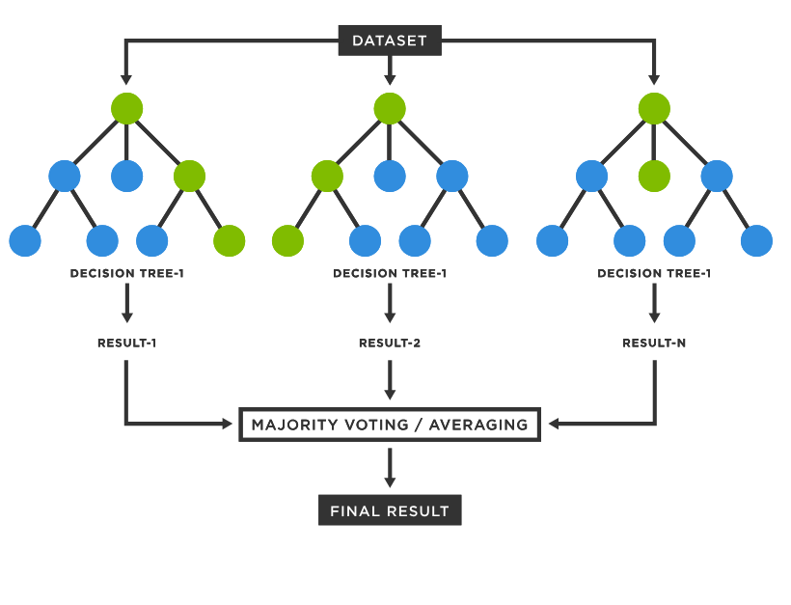
Random Forest
Pros:
- Limits overfitting without additional steps
- Decorrelated trees used
- Good for large datasets and faster (relative) training times due to subsetting of predictors
- High accuracy and low variance
Cons:
- Low interpretability
- Time consuming (compared to previous models)
- Computationally expensive

Slide 2
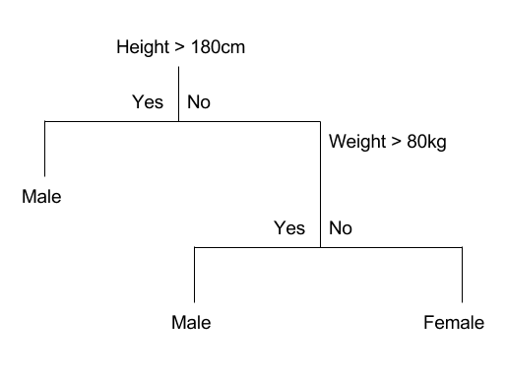
CART model
Pros:
- High interpretability
- Suitable for highly correlated data
Cons:
- High risk of overfitting
- High variance
- Unstable model

